Slide 1

INVESTMENT APPRAISAL METHODS
CHAPTER 10
The managers of all businesses will find themselves faced, from time to time, by Capital Investment decisions.
Capital investment decisions have direct effect on future profitability --- increase in efficiency and reduction in costs
Proper evaluation of Capital expenditure projects is important before taking go a head decision.
Capital expenditures differs from revenue expenditures as they involve bigger outlay of money and benefit will accrue over a long period of time

Slide 2
PLANNING STEPS FOR CAPITAL INVESTMENT DECISIONS
Identification of investment opportunity
Consideration of the alternatives to the project being evaluated.
Acquiring relevant information.--- form the basis for informed decisions otherwise projects to be abandoned at early stage
Detailed planning is involved.
Taking the investment decisions

Slide 3
PROJECT CLASSIFICATIONS
Replacement of equipment: Maintenance of business – Replacement of worn out or damaged equipment done for continuing business operations.
Replacement of equipment :Cost reduction. Replacement of equipment with more efficient assets helping in reducing cost and increasing profitability.
Expansion of existing products / markets: Expenditure to increase output of existing products, or to expand retail outlets or distribution facilities in the markets now being served.

Slide 4
Expansion into new products / markets. Involving strategic decisions that could change fundamental nature of the business– large capital outlay and delayed pay back period.
Safety and other environmental projects. Expenditures incurred for complying Government orders, labor agreements, or insurance policy terms – mandatory investments. Normally involve non revenue producing projects.
Research and development. The expected cash flows from R&D are often too uncertain to warrant a standard DCF analysis. Decision tree analysis and real option approach are used.
Long term contracts. For provision of products and services involving cost and revenue over multiple of years (DCF analysis done before signing contract)

Slide 5
PRINCIPAL METHODS OF EVALUATING CAPITAL PROJECTS
The return on investment method, or accounting rate of return method
The payback method
Discounted cash flow method(DCF)
(i) The net present value method (NPV)
(ii) The internal rate of return method (IRR)
(iii) MIRR (Modified internal rate of return)
Profitability Index

Slide 6
The accounting rate of return method
The accounting rate of return method of
appraising a capital project is to estimate the
accounting rate of return or return on investment
(ROI) that project should yield. If it exceeds a target
rate of return, the project will be undertaken.
Unfortunately, there are several different definitions
of “return on investment”. One of the most popular
is as follows:
ARR = Estimated average profit X 100 %
Estimated average investment

Slide 7
The others include:
ARR = Estimated total profits X 100 %
Estimated initial investment
ARR = Estimated average profits X 100 %
Estimated initial investment
There are arguments in favor of each these definitions.
The most important point is, however, that the
method selected should be used consistently.

Slide 8
Example : The accounting rate of return
A company has a target accounting rate of return of
20 % and is now considering the following project.
Capital Cost of the Asset Rs 80,000
Estimated life of the asset 4 years
Estimated profit before depreciation
Year 1 Rs 20,000
Year 2 25,000
Year 3 35,000
Year 4 25,000
The capital asset would be depreciated by 25 % of its cost each
year, and will have no residual value. Should the project be
Undertaken.

Slide 9
Solution
The annual profits after depreciation, and mid-year
net book value of the asset, would be as follows:
Year Profit after Mid-year net ARR in
depreciation book value the year %
1 0 70,000 0
2 5,000 50,000 10
3 15,000 30,000 50
4 5,000 10,000 50

Slide 10
As the table shows, the ARR is low in early stages
of the project, partly because of low profits in year 1
but mainly due the net book value of the asset is
much higher in its life.
The project does not achieve the target 20 % in its
first 2 years, but exceeds it in years 3 and 4 . So it
should be under taken.
However when the ARR from a project varies from
year to year, it makes sense to take an overall or
average view of the project’s return. In this case we
should look at the return as a whole over the four
years period of time.

Slide 11
Total profit before depreciation over 4 years Rs 105,000
Total profit after depreciation over four years 25,000
Average annual profit after depreciation 6,250
Original cost of investment 80,000
Average book value over the 4 years period (80,000+0)/2
= Rs 40,000
The average ARR = 6250 / 40,000 = 15.625 %
The project would not be undertaken because it would fail to
yield the target return of 20 %.

Slide 12
The ARR of mutually exclusive projects.
The project with the higher ARR will be accepted
provided the expected ARR is higher than the
company’s target ARR.
Example:
Arrow ltd wants to buy a new item of equipment,
which will be used to provide service to customers of
the company. Two models of equipments are
available in the market, one with slightly higher
capacity and greater reliability than other the
expected cost and profits of each item as follows:

Slide 13
Equipment item Equipment item
X Y
Capital Cost Rs 80,000 Rs. 150,000
Life 5 years 5 years
Profits before depreciation
Year 1 50,000 50,000
Year 2 50,000 50,000
Year 3 30,000 60,000
Year 4 20,000 60,000
Year 5 10,000 60,000
Disposal value 0 0
ARR is measured as the average annual profit after depreciation, divided
by the average net book value of the assets. Which item of the equipment
should be selected, if any , if the company’s target ARR is 30 % ?

Slide 14
Solution
Eqpmnt X EqpmntY
Total profit over life
Before depreciation 160,000 280,000
After depreciation 80,000 130,000
Average annual profit
After depreciation 16,000 26,000
(Capital Cost +disposal Value) /2 40,000 75,000
ARR 40% 34.7%
Both projects would earn a return in excess of 30%, but
since equipment X would earn a bigger ARR, it would be
preferred to equipment Y, even though the profits from Y
would be higher by an average of Rs. 10,000 a year.

Slide 15
THE DRAW BACKS OF ARR METHOD
The ARR method of capital investment has serious
draw back that it does not take account of timing of
the profits from an investment. When ever capital is
invested in a project, money tied up in one project
cannot be invested anywhere else until the profits
come in. Management should be aware of the
benefits of early repayments from an investment,
which will provide the money for other investment.

Slide 16

THE PAY BACK METHOD
The payback is defined as the time it takes
the cash inflow from a capital investment
project to equal the cash outflows, usually
expressed in years.
When deciding between 2 or more competing
projects, the usual decision is to accept the
one with the shortest payback.
Pay back is commonly used as a first screening
method.
Project should be rejected if its payback period is
more than the company’s target payback period

Slide 17
Example
Project P Project Q
Capital expenditure Rs 60,000 Rs. 60,000
Cash Inflows
Year 1 20,000 50,000
Year 2 30,000 20,000
Year 3 40,000 5,000
Year 4 50,000 5,000
Year 5 60,000 5,000

Slide 18
Solution
Project P
Year 0 ( 60,000)
Year 1 20,000
Year 2 30,000
Year 3 40,000 only 10,000 more
required in 3rd year
There fore Project P’s pay back period is about
one quarter of the way through year 3 i.e,
( 2.25 years).

Slide 19
Project Q
Year 0 ( 60,000)
Year 1 50,000
Year 2 20,000 only 10,000 more
required in 2nd year
There fore Project Q’s pay back period is about
Half way through year 2 i.e,
( 1.5 years).
Using pay back period alone to judge the Capital
investment projects, project Q would be
preferred. But the returns from project P over its
life are much higher than the returns from
project Q

Slide 20
Conclusion
The pay back period has provided a rough
measure of liquidity and not profitability.
Project P will earn total profits after
depreciation of Rs. 140,000, on an investment
of Rs. 60,000.
Project Q will earn total profits after depreciation of only Rs. 25,000, on an investment of Rs. 60,000.
Pay back can be important, and long payback periods mean capital tied up and also high investment risk, but total project return ought to be taken into consideration as well.

Slide 21
Discounted Cash Flow
The ARR method of project valuation ignores the
timing of cash flows and the opportunity cost of
capital tied up. Pay back considers the time it takes to recover the original investment cost, but ignores total profits over a project’s life.
Discounted cash flow, or DCF for short, is an investment appraisal technique which takes into account both the time value of money and also the profitability over a project’s life. DCF is therefore superior to both ARR and pay back as method of investment appraisal.

Slide 22
Important points about DCF
DCF looks at the cash flows of a project, not the accounting profits. Like the pay back technique, DCF is concerned with liquidity, not profitability. Cash flows are considered because they show the cost and benefits of a project when they occur. For example, the capital cost of a project will be original cash outlay, and not the depreciation charge which is used to spread the capital cost over the asset’s life in the financial accounts.
The timing of the cash flows is taken into account by discounting them. The effect of discounting is to give a bigger value per Rupee for cash flows that occur earlier, for example Rs 1 earned after 1 year will be worth more than Rs 1 earned after 2 years, which in turn be worth more that Rs 1 earned after 3 years or so on.

Slide 23
Discounted Payback period
Some Companies use variant of the regular payback,
the Discounted payback period, which is similar to
regular payback period except that the expected cash
flows are discounted by the project’s cost of capital.
By Discounted pay back period we mean the number
of years required to recover the Investment from
discounted net cash flows. t
Each cash inflow is divided by (1+r) where
t= year in which cash flow occurs, r = projects cost
of capital

Slide 24
Example : Discounted payback
Project S: Year 0 1 2 3 4
Net Cash Flows -1000 500 400 300 100
Discounted NCF(@10%) -1000 455 331 225 68
Cumulative discounted NCF -1000 -545 -214 11 79
Pay back period S = 2.95 years
Project L Year 0 1 2 3 4
Net Cash Flows -1000 100 300 400 600
Discounted NCF(@10%) -1000 91 248 301 410
Cumulative discounted NCF -1000 -909 -661 -360 50
Payback period L = 3.88 years

Slide 25
NET PRESENT VALUE (NPV) METHOD
NPV method relies on DCF techniques.
Procedure:
Find the present value of each cash flow, including all inflows and outflows, discounted at the project’s cost of capital.
Sum these discounted cash flows; this sum is defined as the project’s NPV.
If the NPV is positive, the project should be accepted, while if the NPV is negative, it should be rejected. If two projects with positive NPV’s are mutually exclusive, the one with higher NPV should be chosen.

Slide 26
THE EQUATION FOR NPV
NPV= CF0 + CF1 + CF2 +……..+ CFN
1 2 N
(1+R) (1+R) (1+R)
= N CFt
t
(1+R)
T=0
CFt= Expected net cash flow at period t, R = the project’s cost of capital and
N = life of the project.

Slide 27
Example NPV appraisal method
0 r=10% 1 2 3 4
Cash flows -1000 500 400 300 100
In Rs 454.55
330.58
225.39
68.30
NPV Rs 78.82
Note: Cash out flows are treated as negative cash flows. At
10% cost of capital , the above project’s NPV is Rs. 78.82
NPV = -1000 + 500/(1.10) + 400/(1.21) +300/(1.331)+100/(1.4641)=Rs 78.82

Slide 28
How to compute NPV using excel functions
Formula in Cell B5 = B4+NPV(B2,C4:F4)
1 A | B | C | D | E | F
2 r= | 10 %
3 Time | 1 | 2 | 3 | 4 | 5
4 C F | -1000 | 500 | 400 | 300 | 100
5 NPV | Rs 78.62
6 IRR | 14.5%

Slide 29
Conclusion ---
Accept the project with positive NPV. It means that project is generating more cash than is needed to service the debt and to provide the required return to shareholders, and this excess cash accrues solely to the companies stockholders.
NPV zero signifies that project’s cash flows are exactly sufficient to repay the invested capital and to provide the required rate of return on that capital.
Direct relationship between EVA and NPV. NPV is equal to the present
value of the project’s future EVA’s. Accepting +ve NPV should result in
positive EVA and +ve MVA.

Slide 30
Internal Rate of Return (IRR)
The IRR is defined as the discount rate that equates the
present value of the project’s expected cash inflows to the
present value of project’s cost:
PV(Inflows) = PV (Investment Costs)
Or we can also say that the IRR is the rate that forces the
NPV equal to ZERO.
Cfo + CF1 + CF2 +………+ CFn = 0
1 2 n (1+IRR) (1+IRR) (1+IRR)

Slide 31
Example of IRR
= N CFt
NPV= t =0
(1+IRR)
T=0
0 IRR 1 2 3 4
Cash flows -1000 500 400 300 100
Sum of Pv’s for CF 1-4 1000
NPV 0

Slide 32
-1000 + 500 + 400 + 300 + 100 = 0
1 2 3 4
(1+IRR) (1+IRR) (1+IRR) (1+IRR)
IRR = 14.5 % , In case if the cost of capital is < 14.5 %
then the project should be accepted.

Slide 33
Computation of IRR
PERIOD C/FLOW 14% PV 15 % PV
Discnt Amt Discnt Amt Factor Factor
YEAR 0 -1000 1 -1000 1 -1000
YEAR 1 500 0.877 438.5 0.870 435
YEAR 2 400 0.769 307.6 0.756 302.4
YEAR 3 300 0.675 202.5 0.658 197.4
YEAR 4 100 0.592 59.2 0.572 57.2
NPV 7.8 -8
We can see that the rate is between 14 % and 15 % therefore
We will use the INTERPOLATION technique to find IRR

Slide 34
Interpolation technique
IRR = A + X * (B-A)
X-Y
Where A is one rate of return
B is an other rate of return
X is NPV at rate A
Y is NPV at rate B
IRR = 14 % + 7.8 * (15-14)
7.8 –(-8)
IRR = 14 % + 7.8 *(1)
15.8
IRR = 14 % +0.494 = 14.5 % Appx

Slide 35
Proof of IRR
PERIOD C/FLOW 14.5% PV
Discnt Amt Factor
YEAR 0 -1000 1 -1000
YEAR 1 500 0.873 436.6
YEAR 2 400 0.763 305.3
YEAR 3 300 0.666 199.9
YEAR 4 100 0.581 58.2
NPV 0

Slide 36
PROFITABLITY INDEX
PI = PV OF FUTURE CASH FLOWS
INITIAL COST
n CFt
PI = t
t=1 (1+r)
CF0
PI = 1078.82 / 1000 = 1.079

Slide 37
Comparison of NPV and IRR
In many respects NPV is better than IRR method.
Why some time a project with lower IRR may be preferable
to a mutually exclusive alternative with a high IRR ?
NPV Profile : A graph that plots a project’s NPV against the
cost of capital rates is defined as NET PRESENT VALUE
PROFILE. Profiles for project S and L are shown in the next
Slide
Recall that IRR is defined as discount rate where at which a
projects NPV equals zero. Therefore, the point where projects
Net present value profile crosses the horizontal axis indicates
the project’s internal rate of return. ( IRR Proj S = 14.5% and
Project L = 11.8 %)

Slide 38
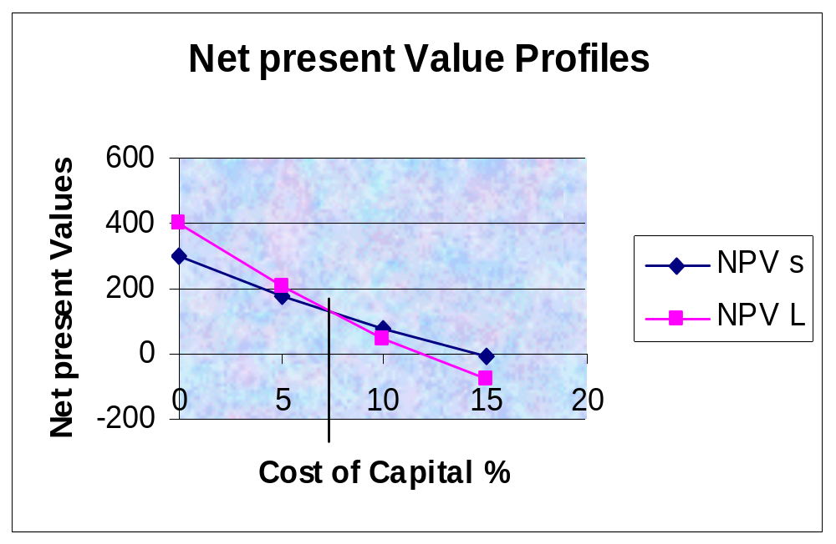

Slide 39
DATA FOR NET PRESENT VALUE PROFILE GRAPH
COST OF CAPITAL NPVs NPV L
0 % $ 300 $ 400
5 180.42 206.50
10 78.82 49.18
15 -8.33 -80.14

Slide 40
NPV RANKING DEPENDS ON THE COST OF CAPITAL
NPV profiles of project L and S declines as the cost of
Capital increases.
Project L has the higher NPV when the cost of capital is low,
While project S has the higher NPV if the cost of capital is
greater than 7.2 % cross over rate.
Project L’s NPV is more sensitive to changes in the cost of
capital than is NPVS, that is project L NPV profile has a
steeper slope, indicating that a given change in rate ‘r’ has a
greater effect on NPV L than on NPV S.
Note: IF a project has most of its cash flows coming in the
early years, its NPV will not decline very much if the cost of
capital increases and vice versa.

Slide 41

Evaluating Independent projects
If independent projects are being evaluated then NPV and IRR criteria will always lead to same accept and reject decisions.
When project’s cost is less than its IRR, its NPV will always be positive and we should accept the project.

Slide 42
Evaluating Mutually exclusive projects
Under mutually exclusive case either one of the project can be chosen or both can be rejected.
NPV profile helps in evaluating the projects.
If cost of capital is greater than the CROSS OVER RATE (7.2 %) , then NPV s is larger than NPV L and IRRs exceeds IRR L.
If r is greater than the cross over rate of 7.2 % both methods will lead to selection of project S. If r is less than the cross over rate than NPV suggest Project L where as IRR suggest Project S to be selected.
Logic suggest that NPV method is better as it will lead to addition in share holders wealth.

Slide 43
What causes NPV profiles of project S & L to cross ?
When project size or scale difference exist. Meaning that the cost of one project is larger than the other.
When timing difference exists, meaning that the timing of cash flows from the two projects differs.
As a result of the above two factors the company will have
different amounts of funds available for investment in
different years. If a company chooses to invest in a project
involving more cost than Co. require more money at time 0.
Similarly for project with equal size but one with large early
cash flows will provide more funds for re investment in early
years. The rate of return at which the differential cash flow can
be invested is a CRITICAL ISSUE.

Slide 44
How to resolve this conflict ?
How useful is to generate cash flows sooner rather than later ?
The value of early cash flows depends upon on the return we can earn on those cash flows, that is , the rate at which we can reinvest them.
The NPV assumes implicitly assumes that the rate at which cash flows can be reinvested is the cost of the capital, where as IRR assumes that the company can reinvest at IRR .
NPV is more reliable in assuming that the Cash flow can be reinvested at the Cost of capital.

Slide 45
Multiple IRR’s
In case of non normal cash flows the project will two IRR’s
Year 0 Year 1 Year 2
-1.6 10 -10
NPV = -1.6 + 10 + -10 = 0
0 1 2
(1+IRR) (1+IRR) (1+IRR)

Slide 46
NPV Profile for Project M
IRR2 400 %
1.0
0.5
0
-0.5 100 200 300 400 500
-1.0
-1.5 IRR1 25 %

Slide 47
Modified IRR or MIRR
Terminal Value
PV of Cost = n = PV of terminal Value
(1 + MIRR )
Modified IRR assumes that cash inflows are re invested at the
cost of Capital and not at IRR rate.
The compounded future value of the cash inflows is also
called the terminal value. The discount rate that forces the
present value of the TV to equal to the present value of cost is
defined as MIRR

Slide 48
0 1 2 3 4
Cash Flows -1000 500 400 300 100
r=10% 330
PV of Costs -1000 r=10% 484
r=10% 665.5
Terminal Value (TV) = 1579.5
PV of TV = 1000 MIRRs = 12.1%
NPV 0
If 2 projects of equal size and same life span then NPV and MIRR will
have same decision

Slide 49
Conclusion on Capital budgeting methods
Companies normally employ more than one capital budgeting method as each method will provide somewhat different piece of information to the decision maker.
Pay back and discounted pay back provide indication of both risk and liquidity of the project.
NPV method gives a direct measure of the dollar benefit of the project to the share holders. Therefore it is regarded as the best single measure of profitability.
IRR is also a measure of profitability but it also contains a projects safety margin

